Slide 1
Predicting Online Consumer Intention
Utilizing Supervised Machine Learning to Enhance E-commerce Conversion Rates
- Kevin Glugar

Slide 2

PROBLEM
Problem Statement:
The goal of this project is to predict whether a shopping session will end with a purchase, based on various attributes related to the session. This prediction can help e-commerce platforms enhance their marketing strategies and improve conversion rates.

Slide 3
The dataset
Dataset from UCI Machine Learning
The dataset consists of 12,330 rows with 10 numerical and 8 categorical attributes,
including information about the type and duration of pages visited, bounce and exit rates, and special day proximity. The 'Revenue' attribute, indicating a completed purchase, is used as the class label.

Slide 4
The dataset
Column descriptions
Administrative: Number of administrative pages visited.
Administrative_Duration: Time on administrative pages.
Informational: Number of informational pages visited.
Informational_Duration: Time on informational pages.
ProductRelated: Number of product-related pages visited.
ProductRelated_Duration: Time on product-related pages.
BounceRates: Percentage of visitors exiting without additional tasks.
ExitRates: Percentage ending views at specific pages.
PageValues: Average page value related to transactions.
SpecialDay: Closeness to special days or holidays impacting transactions.
Month: Month of the pageview.
Weekend: Boolean, true if the session is on a weekend.
OperatingSystems: Integer, user's operating system.
Browser: Integer, user's browser.
Region: Integer, user's region.
TrafficType: Integer, type of user traffic.
VisitorType: Type of visitor (New, Returning, Other).
Revenue: Boolean, true if a transaction was completed. purchase.

Slide 5
Model Overview
These models were chosen as they offer a variety of approaches to classification, from simple linear models to more complex ensemble methods, allowing us to explore different aspects of the data and ensure robust results.
Logistic Regression
Random Forest Classifier
It's a simple and fast model, suitable for binary classification tasks.
An ensemble learning method. It creates multiple decision trees and merges them to produce a more accurate and stable prediction.
Support Vector Classifier
Decision Tree Classifier
Performs classification by finding the hyperplane that best separates the classes in the input feature space. It's effective in high-dimensional spaces.
It's a non-parametric model that can capture complex relationships in the data and is easy to understand and visualize.

Slide 6
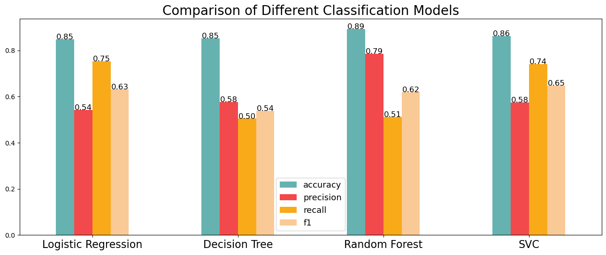
MARKNADSÖVERSIKT
3 MDKR
2 MDKR
1 MDKR
Möjlighet att bygga
Helt inkluderande marknad
Total adresserbar marknad
Frihet att uppfinna
Selektivt inkluderande marknad
Tillgänglig adresserbar marknad
Få konkurrenter
Specifik målmarknad
Tillgänglig marknad som kan betjänas

Slide 7
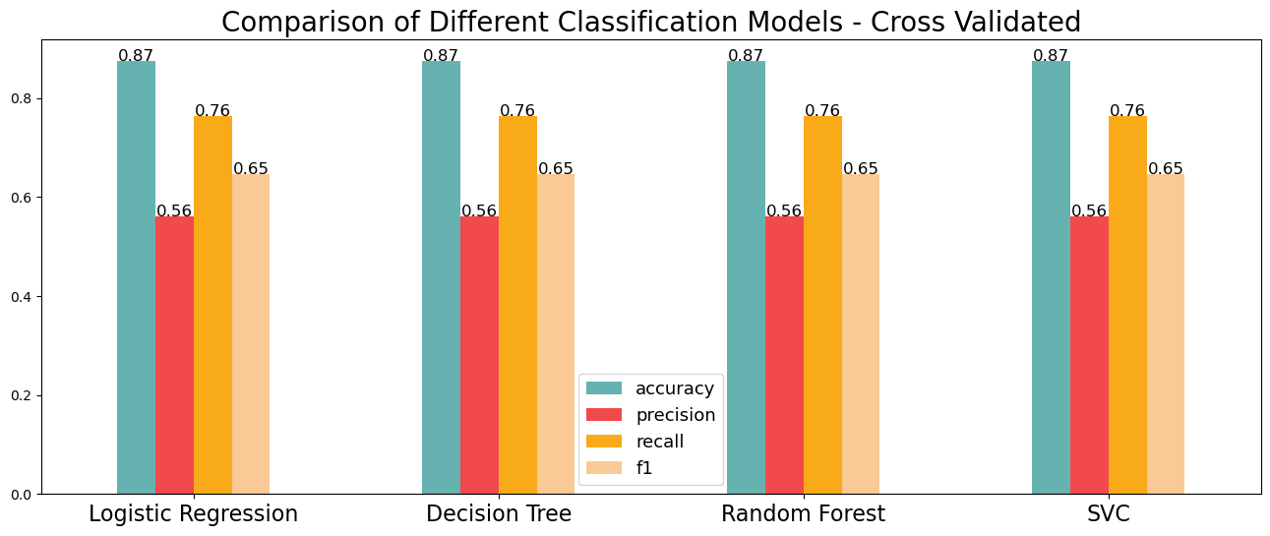
MARKNADSÖVERSIKT
3 MDKR
2 MDKR
1 MDKR
Möjlighet att bygga
Helt inkluderande marknad
Total adresserbar marknad
Frihet att uppfinna
Selektivt inkluderande marknad
Tillgänglig adresserbar marknad
Få konkurrenter
Specifik målmarknad
Tillgänglig marknad som kan betjänas

Slide 8
Final Model Selection
After Hyperparameter tuning with GridSearchCV:
After evaluating all models, I narrowed down the choices to Random Forest and SVC based on their performance metrics.
Random Forest Classifier
The final Random Forest model, with optimized hyperparameters, achieved an accuracy of 87.4%, precision of 60.1%, recall of 79.1%, and an F1 Score of 68.3%.
Support Vector Classifier
This model was not as good...

Slide 9
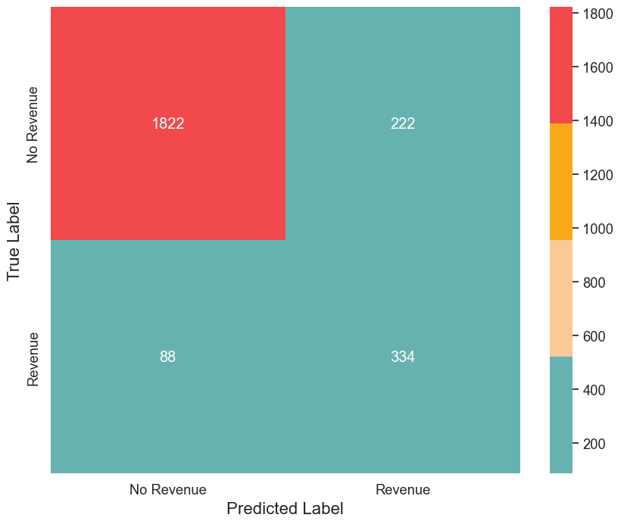
Confusion Matrix
På Contoso tror vi på att ge 110 %. Genom att använda energieffektiva byggmetoder hjälper vi kommersiella företag växa och fostra ett tankesätt där kunden kommer först. Vi blomstrar på grund av vår marknadskunskap och ett fantastiskt team bakom vår produkt. Som vår VD säger, ”Effektivitet kommer när vi proaktivt omvandlar hur vi gör affärer”.

Slide 10
Breakdown
Confusion Matrix – Random Forest
True Negatives, 1822, represent sessions correctly identified as non-purchases.
False Positives, 222, are sessions incorrectly identified as purchases.
False Negatives, 88, are actual purchases incorrectly labeled as non-purchases.
True Positives, 334, represent correctly identified purchase sessions.

Slide 11


Model Use case
Marketing
Avoid Cost
Identifying potential future customers (True Positives), to enhance targeted marketing strategies.
The model effectively identifies non-purchase sessions, helping to avoid unnecessary marketing costs.

Slide 12
Challenges and learnings

Slide 13
Thank you
Kevin Glugar

